Slide 1
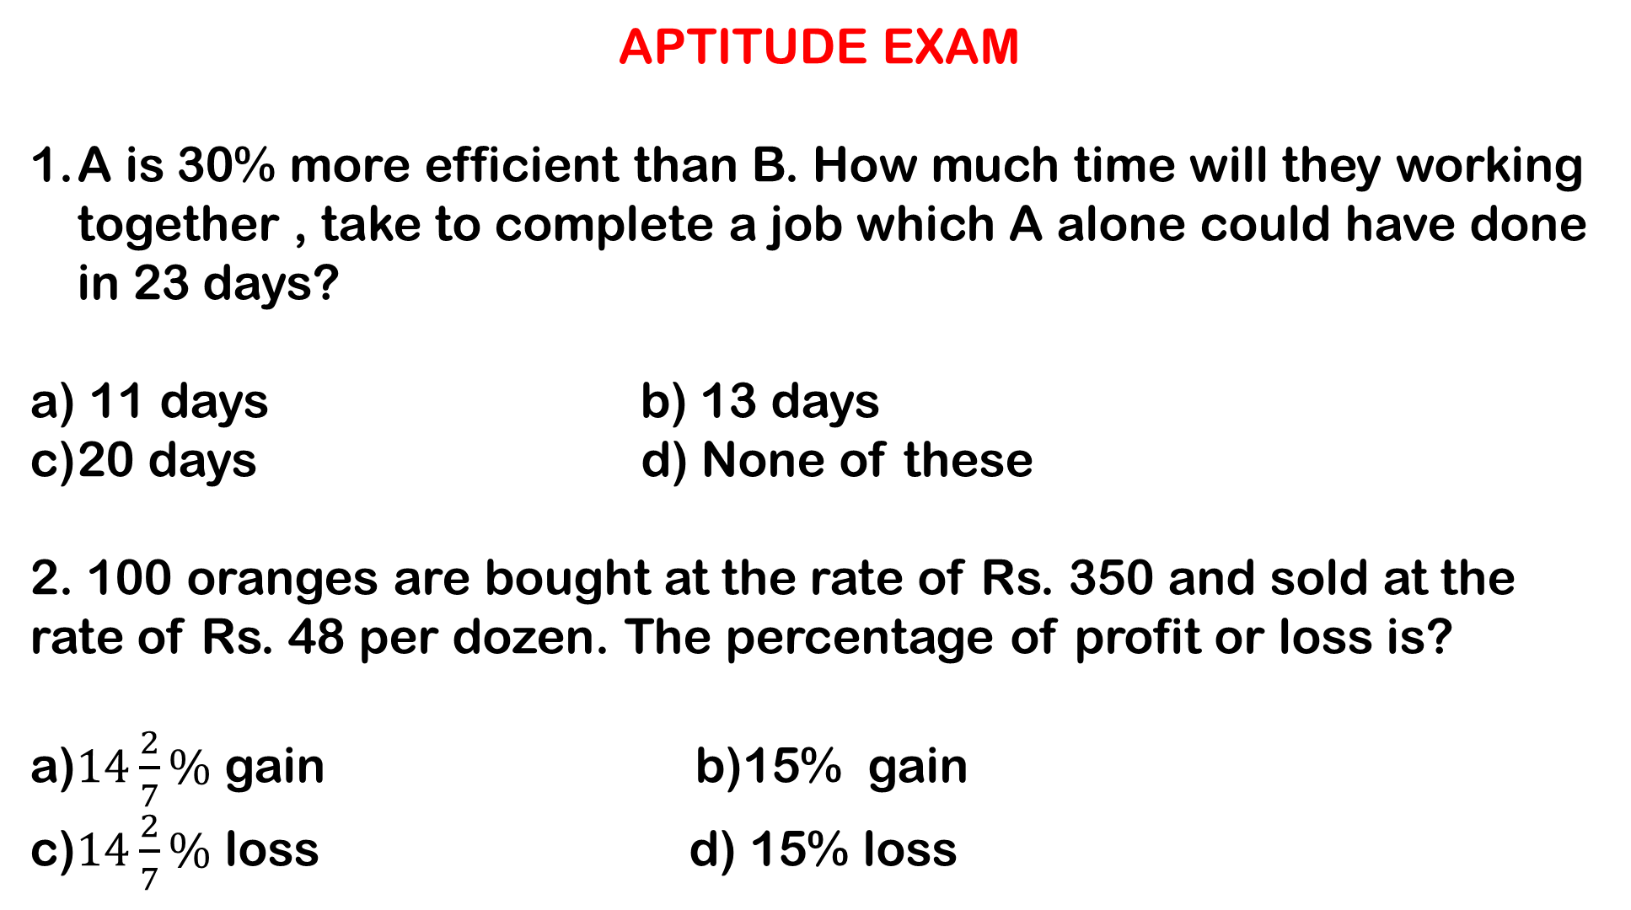
APTITUDE EXAM
A is 30% more efficient than B. How much time will they working together , take to complete a job which A alone could have done in 23 days?
a) 11 days b) 13 days
20 days d) None of these
2. 100 oranges are bought at the rate of Rs. 350 and sold at the rate of Rs. 48 per dozen. The percentage of profit or loss is?
a)$14\frac{2}{7}\%$ gain b)15% gain
c)$14\frac{2}{7}\%$ loss d) 15% loss

Slide 2
3. A boat running upstream takes 8 hours 48 minutes to cover a certain distance , while it takes 4 hours to cover the same distance running downstream . What is the ratio between the speed of the boat and speed of the water current respectively ?
a)2 : 1 b)3 : 2
c)8 : 3 d) None of these
4. A alone can do a piece of work in 6 days and B alone in 8 days. A and B undertook to do it for Rs. 3200. with the help of C, they completed the work in 3 days. How much is to be paid to C?
a)Rs. 375 b)Rs. 400
c)Rs. 600 d)Rs. 800

Slide 3
5.Robert is travelling on his cycle and has calculated to reach point A at 2 P.M. if he travels at 10 kmph , he will reach there at 12 noon if he travels at 12 kmph. At what speed must he travel to reach A at 1 P.M. ?
a)8 kmph b)11 kmph
c)12 kmph d)14 kmph
6. Ayesha’s father was 38 years of age when she was born while her mother was 36 years old when her brother four years younger to her was born . What is the difference between the ages of her parents?
a)2 yrs. b)4 yrs.
c)6 yrs. d)8 yrs.

Slide 4
7. Find the ratio in which rice at Rs. 7.20 a kg be mixed with rice at Rs. 5.70 a kg to produced a mixture worth Rs. 6.30 a kg?
a)1 : 3 b)2 : 3
c)3 : 4 d)4 : 5
8. On dividing a number by 68, we get 269 as quotient and 0 as a remainder . On dividing the same number by 67 , what will be remainder ?
a)0 b)1
c)2 d)3

Slide 5
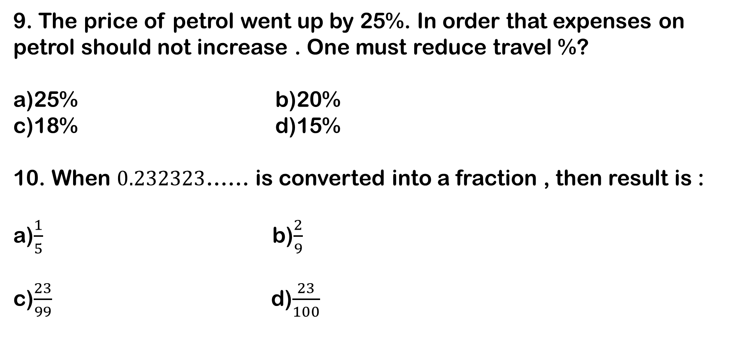
9. The price of petrol went up by 25%. In order that expenses on petrol should not increase . One must reduce travel %?
a)25% b)20%
c)18% d)15%
10. When $0.232323$…… is converted into a fraction , then result is :
a)$\frac{1}{5}$ b)$\frac{2}{9}$
c)$\frac{23}{99}$ d)$\frac{23}{100}$

Slide 6
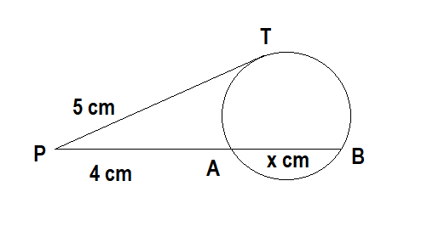
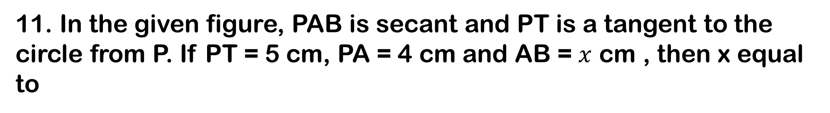
11. In the given figure, PAB is secant and PT is a tangent to the circle from P. If PT = 5 cm, PA = 4 cm and AB = $x$ cm , then x equal to
2.5 cm
2.6 cm
2.25 cm
2.75 cm

Slide 7
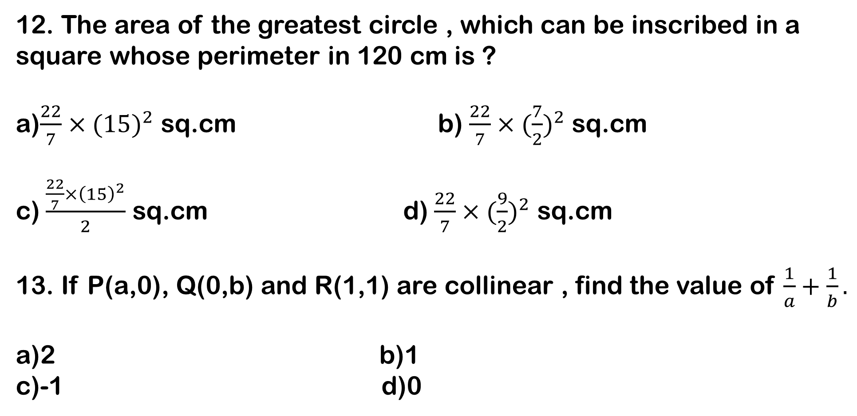
12. The area of the greatest circle , which can be inscribed in a square whose perimeter in 120 cm is ?
a)$\frac{22}{7}{×(15)}^{2}$ sq.cm b) $\frac{22}{7}{×(\frac{7}{2})}^{2}$ sq.cm
c) $\frac{\frac{22}{7}{×\left(15\right)}^{2}}{2}$ sq.cm d) $\frac{22}{7}{×(\frac{9}{2})}^{2}$ sq.cm
13. If P(a,0), Q(0,b) and R(1,1) are collinear , find the value of $\frac{1}{a}+\frac{1}{b}.$
a)2 b)1
c)-1 d)0

Slide 8
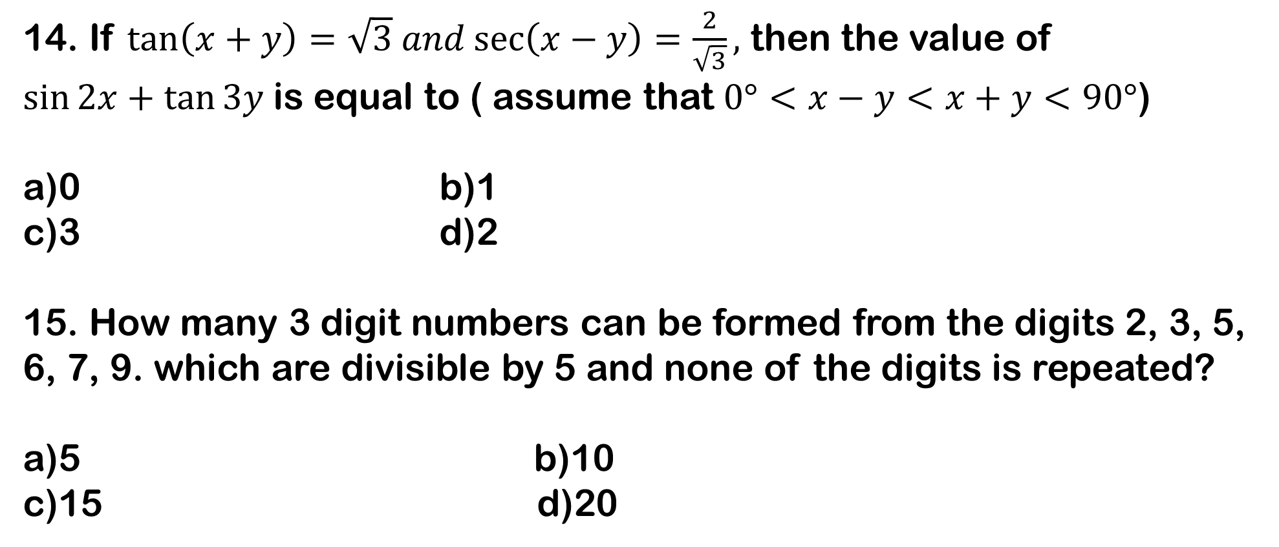
14. If $\tan\left(x+y\right)=\sqrt{3} and\sec\left(x−y\right)=\frac{2}{\sqrt{3}},$ then the value of $\sin{2x+\tan{3y} }$is equal to ( assume that $0°<x−y<x+y<90°$)
a)0 b)1
c)3 d)2
15. How many 3 digit numbers can be formed from the digits 2, 3, 5, 6, 7, 9. which are divisible by 5 and none of the digits is repeated?
a)5 b)10
c)15 d)20

Slide 9
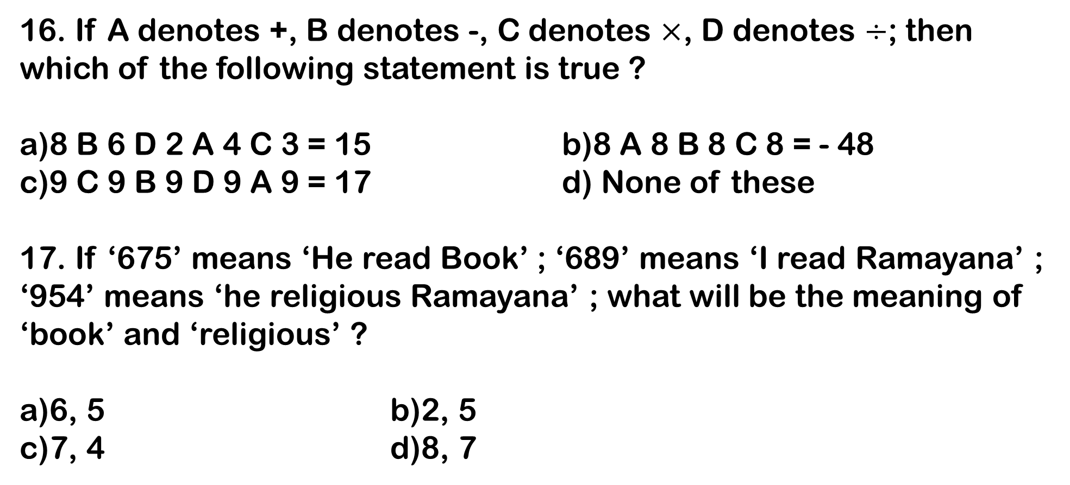
16. If A denotes +, B denotes -, C denotes $×$, D denotes $÷$; then which of the following statement is true ?
a)8 B 6 D 2 A 4 C 3 = 15 b)8 A 8 B 8 C 8 = - 48
c)9 C 9 B 9 D 9 A 9 = 17 d) None of these
17. If ‘675’ means ‘He read Book’ ; ‘689’ means ‘I read Ramayana’ ;
‘954’ means ‘he religious Ramayana’ ; what will be the meaning of ‘book’ and ‘religious’ ?
a)6, 5 b)2, 5
c)7, 4 d)8, 7

Slide 10
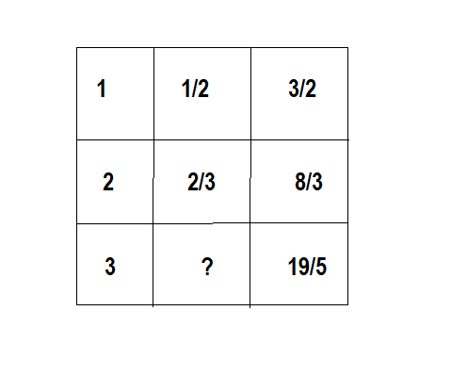
18. Complete the series : 8, 7, 15, 22, 37, ?
a)53 b)59
c)49 d)56
Find the missing number
a)1/2
b)2/3
c)3/4
d)4/5

Slide 11
20. My friend and I started simultaneously toward each other from two places 100 m apart. After walking 30 m, my friend turns to left and goes 10 m , and then he turns right and goes 20 m and then he turns right again and comes back to the road on which he had started walking. If we walk with the same speed, what is the distance between us at this point of time ?
a)50 m b)20 m
c)30 m d)40 m

Slide 12

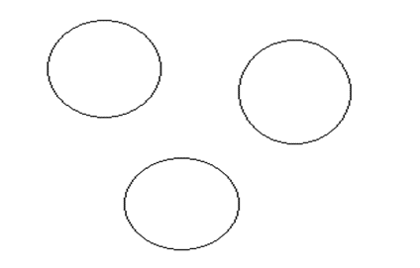
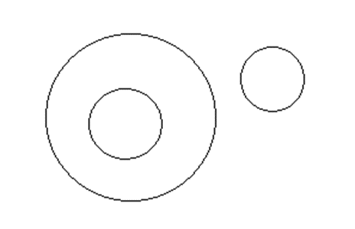
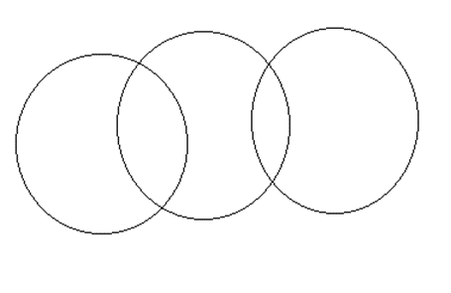
21. Select the correct diagram : Mammal, Cow, Bat
a) b) c) d)
22. A is the mother of B, C is the son of A, D is the brother of E, E is the daughter of B. Who is the grand mother of D ?
A b) B
c) D d) C

Slide 13
23. In a queue, Amrita is 10th from the front while Mukul is 25th from behind and Mamata is just in the middle of the two. If there be 50 persons in the queue, What positions does Mamata occupy from the front ?
a)20th b)19th
c)18th d)17th
24. On 5th December 1993, one couple celebrated their anniversary on Sunday. What will be the day on their anniversary in 1997?
a)Wednesday b)Thursday
c)Friday d)Tuesday

Slide 14
25. Insects : Entomology :: Whales : ?
a)Cetology b)Mycology
c)Ophiology d)Agrology
26. Count the number of triangles and squares in the given figure
a)26, 5
b)28, 5
c)26, 6
d)28, 6

Slide 15
27. In a day the hands of a clock are at right angle ---
a)22 times b)4 times
c)44 times d)6 times
28. Complete the letter series: a__caab__a__bcaab__a__b__a
a)cbacba b)bcacac
c)acbaca d)bbacaa

Slide 16
29. Triangle represents Teachers, circle represents Players , rectangle represents Singers.
How many Singers are neither Players nor Teachers?
a)4
b)17
c)28
d)9

Slide 17
30. Statement : Indian decorator’s company is committed to get your houses well decorated.
Assumptions: i) Only Indian decorator’s company can decorate houses.
ii) People desire to get their houses decorated by some good company.
Only Assumption I is implicit.
Only Assumption II is implicit.
Both Assumption I and II are implicit.
Neither Assumption I nor II is implicit.

